Slide 1
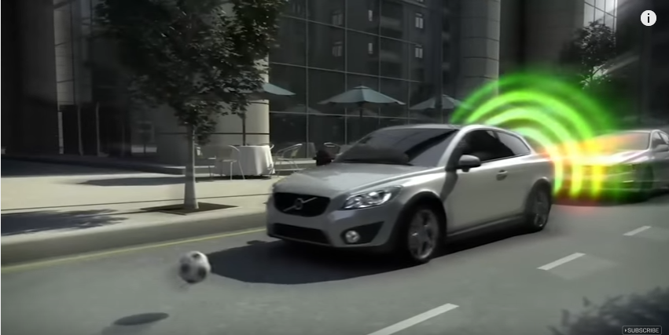
Automatic Braking System
Kamalpreet Grewal - 40010401
Jivanjot Singh Bajaj - 40030329
Ganesh Santhar - 40010625
oyedepo opeyemi-27216386

Slide 2
Motivation(Why this Project)
AIM: Develop an embedded system project based on ARM cortex M0+ for collision
Prevention in automobile.
Objective: The main objectives of this project are:
To develop a Hardware design for Automatic braking System
To develop the functional modules of the braking system
To develop a low cost and efficient working prototype of ABS

Slide 3
Overview
Today we are going to present our Project “Automatic Braking System”
built based on ARM Cortex M0+
Project requirement
System overview
System Design
Design
Working Model
Test Results
Future Enhancements

Slide 4
Project Requirements
Hardware Requirements
Freedom board - FRDM-KL25Z
Ultrasonic Sensor - HC-SR04
Motor Driver - L293DNE
Robot Car Chassis kit
Voltage Divider
Bluetooth Module HC 05
Power Supply Units
Software Requirements
GCC Cross Compiler Tools for ARM
MIT App inventor
Mbed Library

Slide 5
System Overview
The Automatic Braking System comprises of three functional modules, which enables it to achieve its goal. The Modules are
Steering Module – conducts the driver module through user interface
Motor Driver Module – drives the RC vehicle
Obstruction detection Module – detects the obstacle

Slide 6
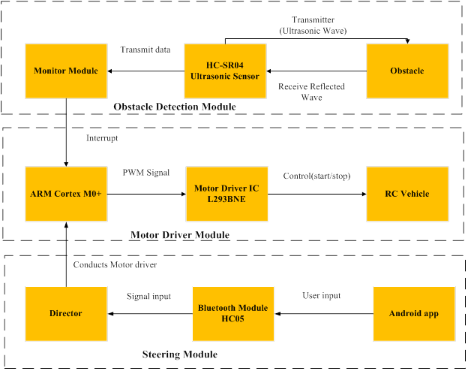
System Design

Slide 7
Steering Module
This module provides the user a way to control the RC vehicle.
The module consists of the below components:
FRDM KL25Z (Arm Cortex M0+ Microcontroller)
Director software
Bluetooth Module HC-05
Android app

Slide 8
Obstruction Detection Module
This is the core module of ABS because it detects the obstacles to RC vehicle and feedbacks to MCU. It consists of below parts
FRDM KL25Z (Arm Cortex M0+ Microcontroller)
Monitor Module
Ultrasonic Sensor HC SR04

Slide 9
Motor Driver Module
This module implements the driving functionality of the Automatic Braking system. It achieves the requirements using the components below
FRDM KL25Z (Arm Cortex M0+ Microcontroller)
Motor driver Software
Dual Bridge Motor Driver IC L293DNE
Robot Chassis Vehicle

Slide 10
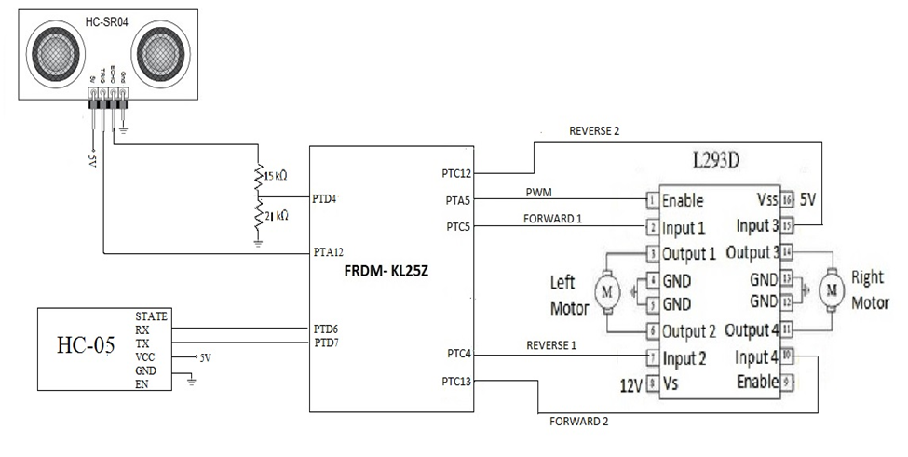
System Interfacing

Slide 11
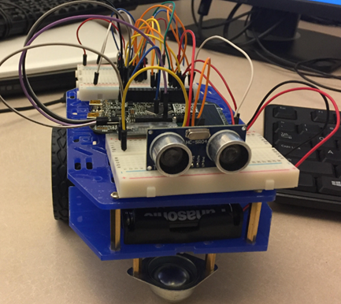
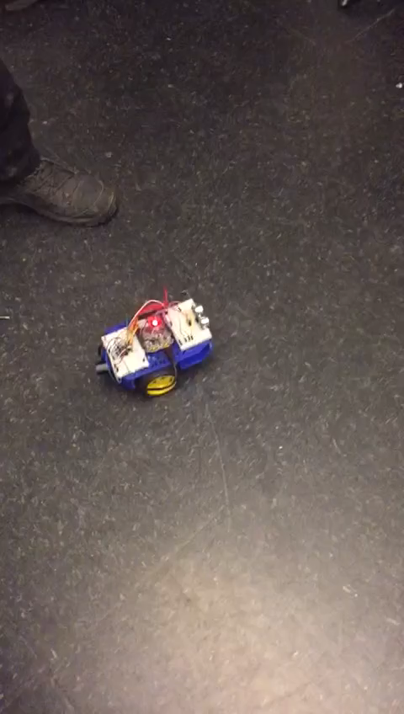
Working Model - Demo

Slide 12
Test Results
Sl no | Test Case ID | Test Case Name | Test description | Expected result | Actual result | Test Status
1 | FUNC_001 | Detect_obstacle | TO verify that whether the sensor detects the obstacle | Reflected signal are captured in echo signal | Yes Reflected signals are captured | Pass
2 | FUNC_002 | Motor_Control | To verify that Motor rotates with the PWM signals from the MCU. | Motor should rotate | Yes the Motor rotates according to the input | Pass
3 | FUNC_003 | Bluetooth_Control | To verify the wireless connection between the module and the App | The App should pair with the Bluetooth Device | The App and Device connected successfully | Pass
4 | FUNC_004 | Bluetooth_Data | To verify the transmission of the Data between the App and Device | The Bluetooth software receives the Data | The Bluetooth transmits the data successfully | Pass
5 | NONFUNC_001 | Performance Test | To verify the system stops the motor within 8 seconds when interrupted by the sensor | The Motor motion stops below 8 seconds | The Motor motion stops at 5 seconds | Pass
6 | NONFUNC_002 | Reliability Test | To verify that the system should perform the required operation at all the time without failure | The system executes the automatic collision control every time | The system was tested working for 5 times for the period of seven days successfully | Pass
7 | NONFUNC_003 | Usability Test | To verify the GUI provided to the user is clear and easy to understand | The user is able to use the system with ease and with less support | The user found the interface usable and very user friendly | Pass

Slide 13
Future Enhancements
Add Obstacle detection sensors in all directions
Add 4 wheeled RC vehicle to have better navigation
Add Camera to capture the obstacle for driver assistance

Slide 14
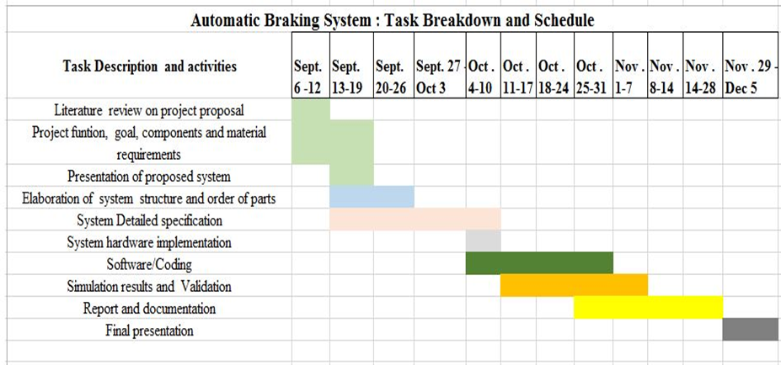
Our Project Schedule

Slide 15
Lesson Learned
MCU functionality, features and interfacing
Collaboration ,
Team work
Time management
Mbed coding on Arm cortex m0+
Our Project Repository
https://github.com/gsanthar/Automatic-Braking-System

Slide 16
Thank You !!

